Slide 1


Slide 2
PRINCIPLES OF HEALTH EDUCATION
Dr. Nikhil Moutam
IIIrd year post graduate
Dept of Public Health Dentistry.

Slide 3
Principles of Health Education
PRINCIPLES OF HEALTH EDUCATION
Lesson plan
Date | 11th June 2019
Time: | 10 minutes
Target audience: | IV year BDS students
Audio-visual Aids : | Projector, Power Point Presentation , Pointer.
Learning Objectives: | To understand the principles of health education

Slide 4
CONTENTS
Introduction
Definition of health education
Objectives of health education
Principles of health education
Conclusion
References

Slide 5

Introduction
What is health education?

Slide 6

Definition
"Health education is a process that informs, motivates and helps people to adopt and maintain healthy practices and lifestyles, advocates environmental changes as needed to facilitate this goal and conducts professional training and research to the same end“
– National conference on preventive medicine in USA.

Slide 7
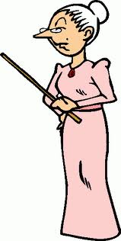
Objectives of health education
Informing people
Motivating people
Guiding into action.

Slide 8

Principals
Credibility
Interest
Participation
Motivation
Comprehension
Reinforcement
Known to unknown
Learning by doing
Setting an example
Community leaders
Good human relations
Feedback

Slide 9

1. Credibility
Degree to which the message is perceived as trustworthy
Unless people have trust and confidence in the communicator, no desired action will ensure after receiving the message.

Slide 10

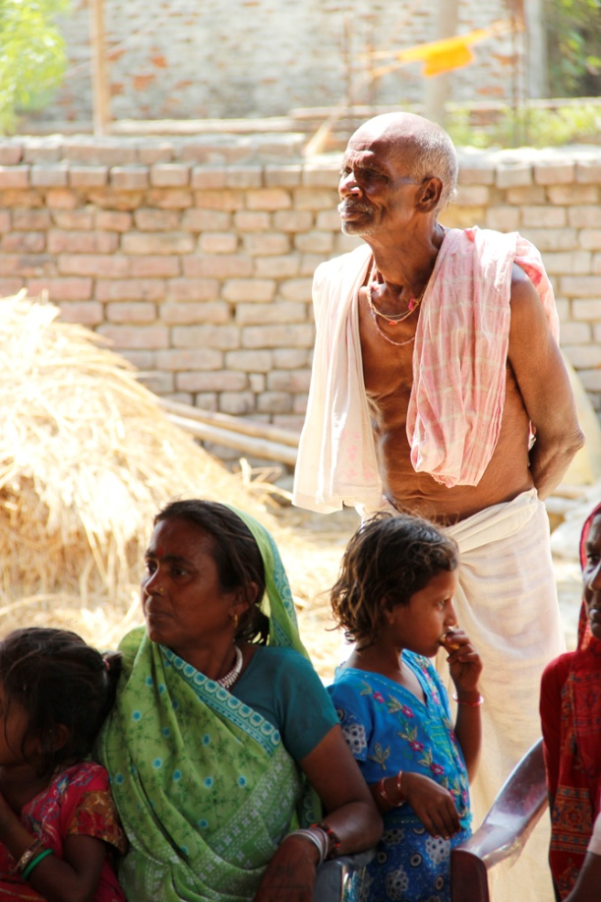

2. Interest
Identify the ‘‘felt needs” of the people, then prepare a programme.

Slide 11


3. Participation
Educator should encourage people to participate in health education programmes
Group discussions

Slide 12

4. Motivation
“A fundamental desire for learning in an individual”

Slide 13


4. Motivation
2 types :
    primary motive
      Hunger, survival, clothing, shelter
    secondary motive
      a word of praise,
      Gifts, rewards,

Slide 14
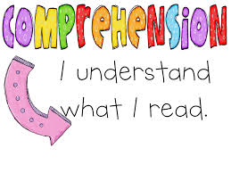


5. Comprehension
Determine the level of literacy
To communicate in the Language best understood by the people.
No -Usage of technical or medical terms.

Slide 15
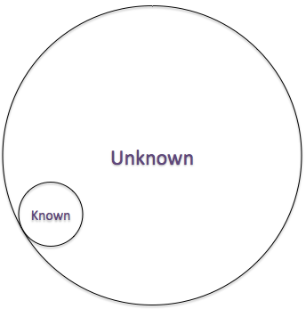
6. Known →unknown
Start with what the people already know and then give the new knowledge
i.e., Existing knowledge is taken as the basic step

Slide 16

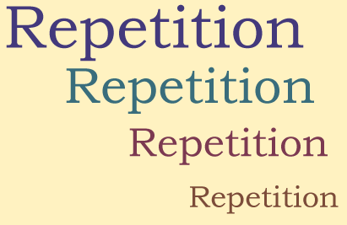
7. Reinforcement
Also called as “booster dose”
Repetition needed

Slide 17
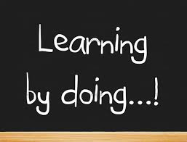
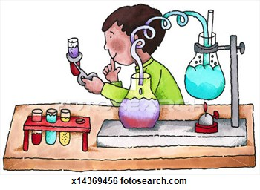
8. Learning by Doing
Learning process accompanied by doing the new things.
Based on famous Chinese proverb
  “if I hear, I forget ;
  if I see, I remember;
  if I do, I know’’.

Slide 18

9. Setting an example
Health educator should set a good example for other people to follow.
Eg: Explaining hazards about smoking is unsuccessful if educator smokes.

Slide 19

10. Good Human Relations
Health educator should :
Have good personal qualities
Maintain friendly relations
A kind and sympathetic attitude

Slide 20

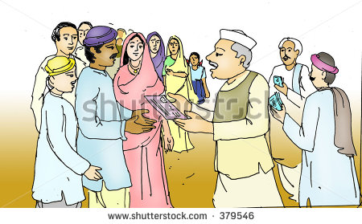
11. Community leaders
Leaders can be used to reach people of the community and to convince them about the need for health education.

Slide 21

12. Feedback
Educator can modify the elements of the system (eg; message, channels) in the light of feedback from the audience.
For effective communication, feedback is of paramount importance.

Slide 22
CONCLUSION
To create awareness among the general public, health education is the main and the most important approach which can bring about a behavioral change of the person

Slide 23
References
Park K. Park's Textbook of Preventive and Social Medicine. 23rd ed. Jabalpur: Banarsidas Bhanot; 2015. p.857-858.
Soben Peter . Child Psychology. Essentials of Preventive and Community Dentistry. 5th ed. New Delhi: Arya (Medi) Publishing House, 2015; p.112-117.
Hiremath SS. Textbook of Public health dentistry. 3rd ed. Elsever publishers.2016.p.57-63.

Slide 24

QUESTIONS

Slide 25


